Slide 1

Amazon Products Optimal Price Prediction
Team 17:
Ananthakrishna Kalle(002772115)
Vaishnavi Yadamreddy(002725890)

Slide 2

Introduction
Amazon's Marketplace: A global leader in e-commerce, Amazon offers an expansive array of products to millions of customers, shaping retail trends and consumer habits.
The Data Revolution: In the age of information, data is the compass by which businesses navigate market trends and consumer preferences.
Dataset as a Lens: The Amazon Products Dataset (2023) provides a snapshot of over 1.4 million products, offering a panoramic view of the market's vast landscape.
Purpose of Analysis: By analyzing this dataset, we aim to unearth patterns and insights that drive purchasing decisions and define successful sales strategies.

Slide 3
Motivation
Primary motivation behind analyzing the Amazon Products Dataset is to leverage big data to gain insights into market dynamics
The dataset is a goldmine for understanding how different products perform, which categories are most popular, and what pricing strategies might be most effective.
For businesses and retailers, these insights are invaluable for strategizing and optimizing their product offerings and pricing models to meet consumer demand and stay competitive.

Slide 4
Goal
Data Analysis: Performing a thorough exploratory data analysis (EDA) to understand the dataset's structure, content, and the relationships between different variables.
Predictive Modeling: Utilizing machine learning algorithms to build predictive models that can forecast market trends, product demand, and price fluctuations
Sentiment Analysis: Analyzing customer reviews to gauge public sentiment towards products, which can influence product development and marketing strategies.

Slide 5

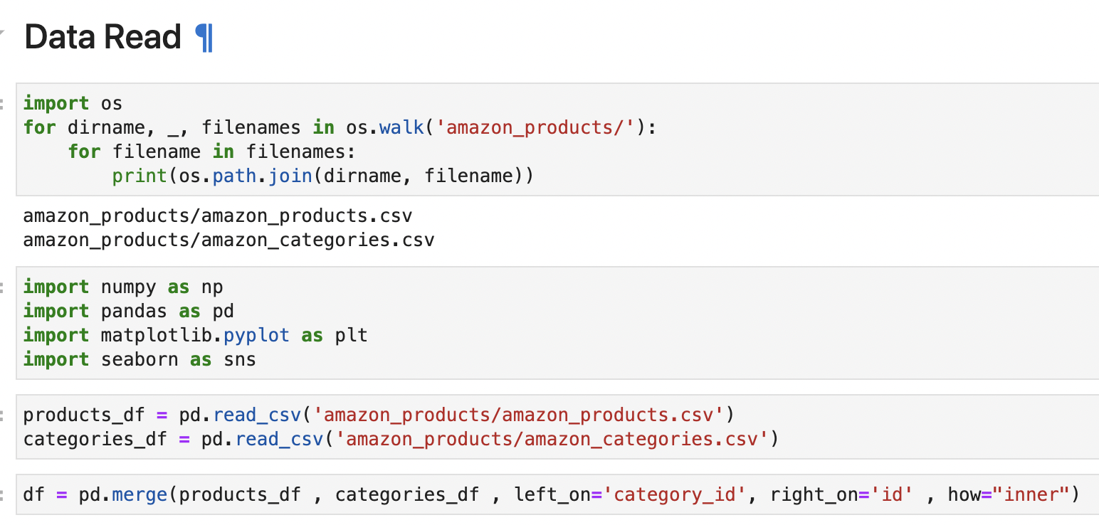
Methodology
Data Collection and Preparation:
Explore the dataset to understand detailed information on 1.4 million products available on Amazon. Prepare the data for model training by organizing it into appropriate directories or data frames.

Slide 6
Feature Engineering
Discount Percentage: A new column 'discount_percentage' is created by applying a function that calculates the discount percentage based on the list price and the actual price. Products with zero list prices are handled to avoid division by zero.
Rating Categories: It categorizes products into qualitative rating groups based on their 'stars' rating. This transforms a numeric rating into an ordinal categorical feature that can be used in machine learning models for classification or ordering.
Price Difference: Finally, a 'difference_price' column is created by subtracting the actual product price from the list price, which could be an indicator of the magnitude of discounts offered.

Slide 7

Visualizations

Slide 8
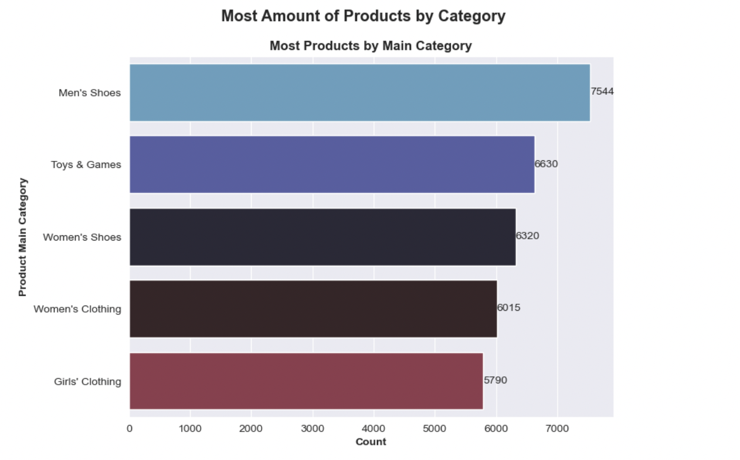
Observation 1: Based on Product Category

Slide 9
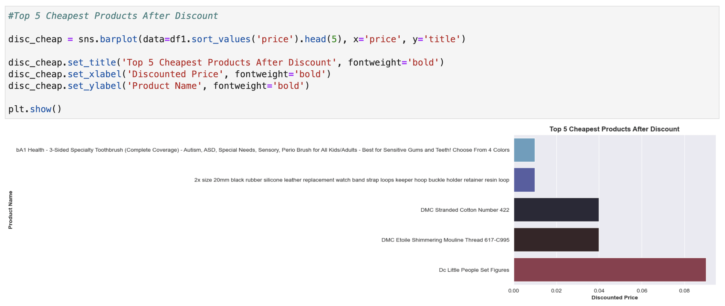
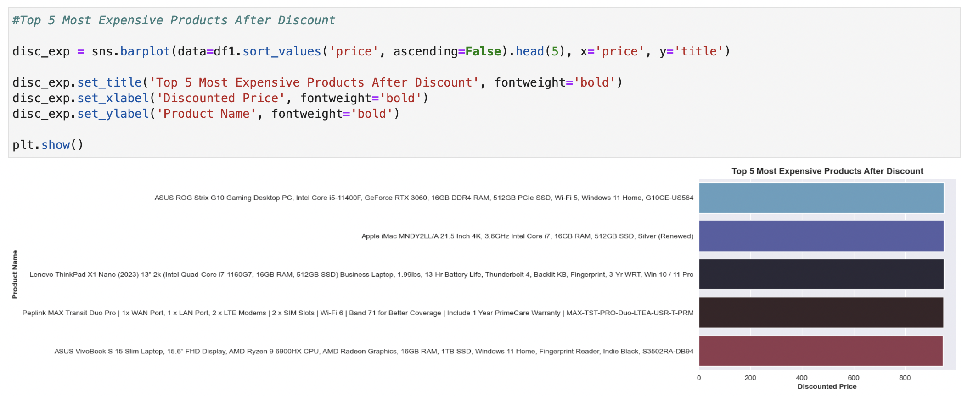

Slide 10
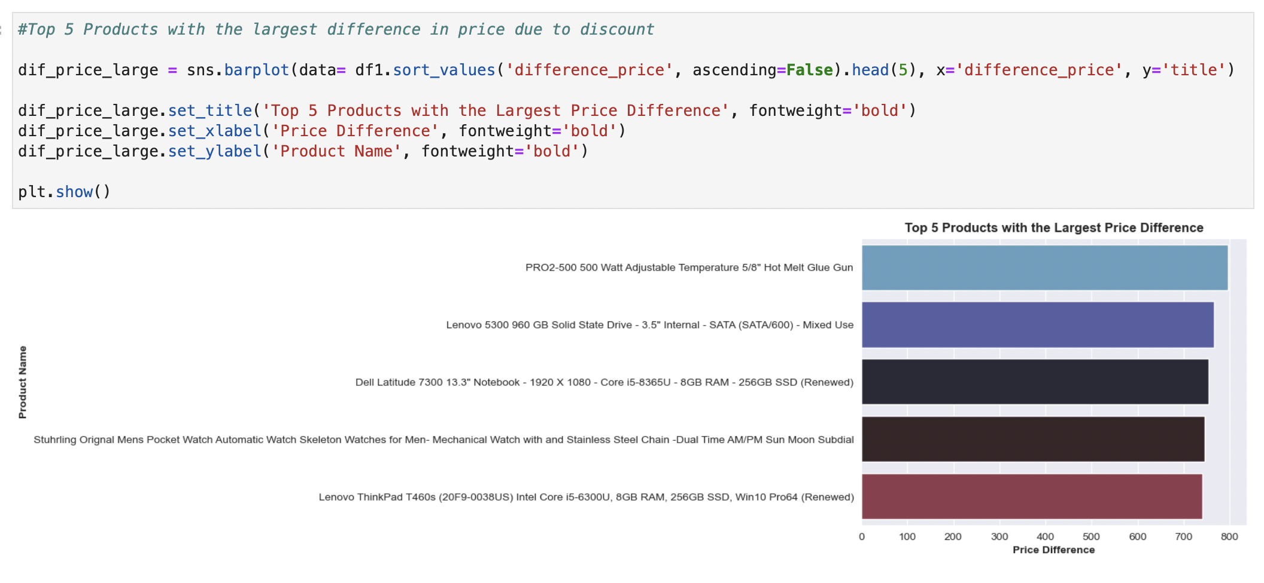

Slide 11
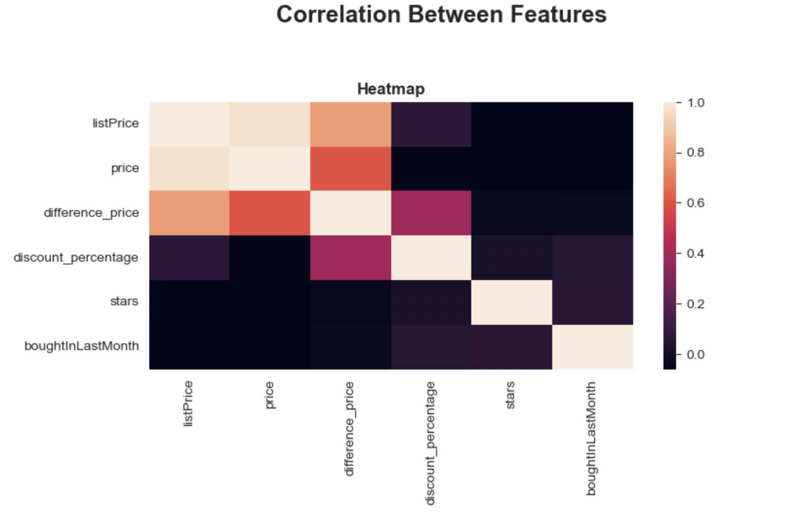
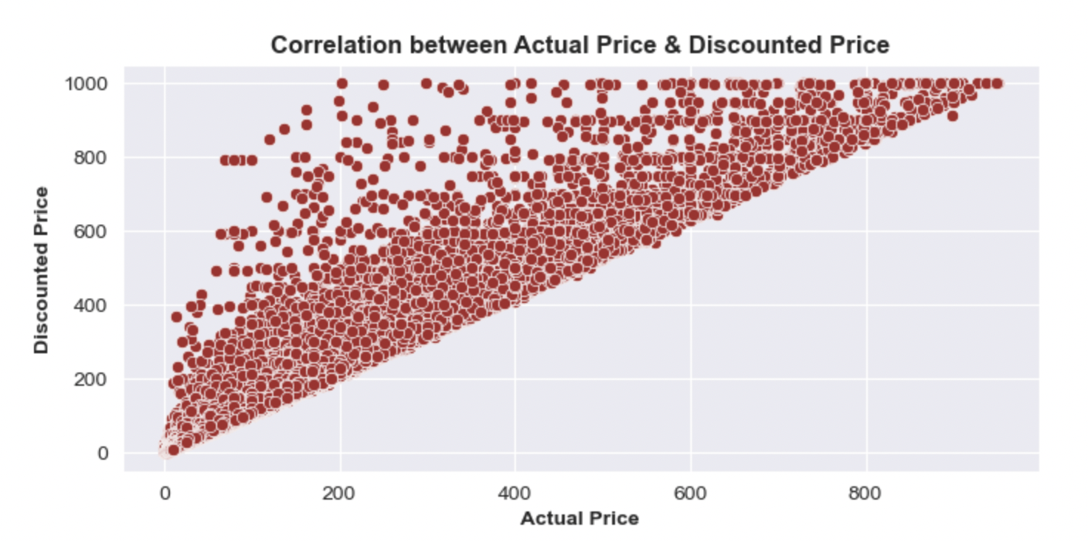
Observation 2: Correlation between Features
'listPrice' and 'price' have a strong negative correlation with 'discount_percentage'. This indicates that as the list price or the actual price of a product increases, the discount percentage tends to decrease, or vice versa.
Positive correlation between 'listPrice' and 'price', which is expected as they are typically directly related. The 'difference_price', which might represent the difference between the list price and the actual price, is positively correlated with both 'listPrice' and 'price', suggesting that a higher price difference is associated with higher absolute prices.
‘boughtInLastMonth’ and ‘stars’ doesn’t show much correlation with other features

Slide 12
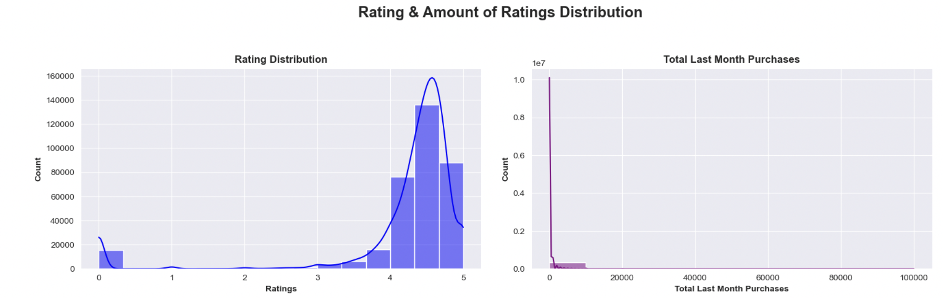
Observation 3: Product Ratings

Slide 13
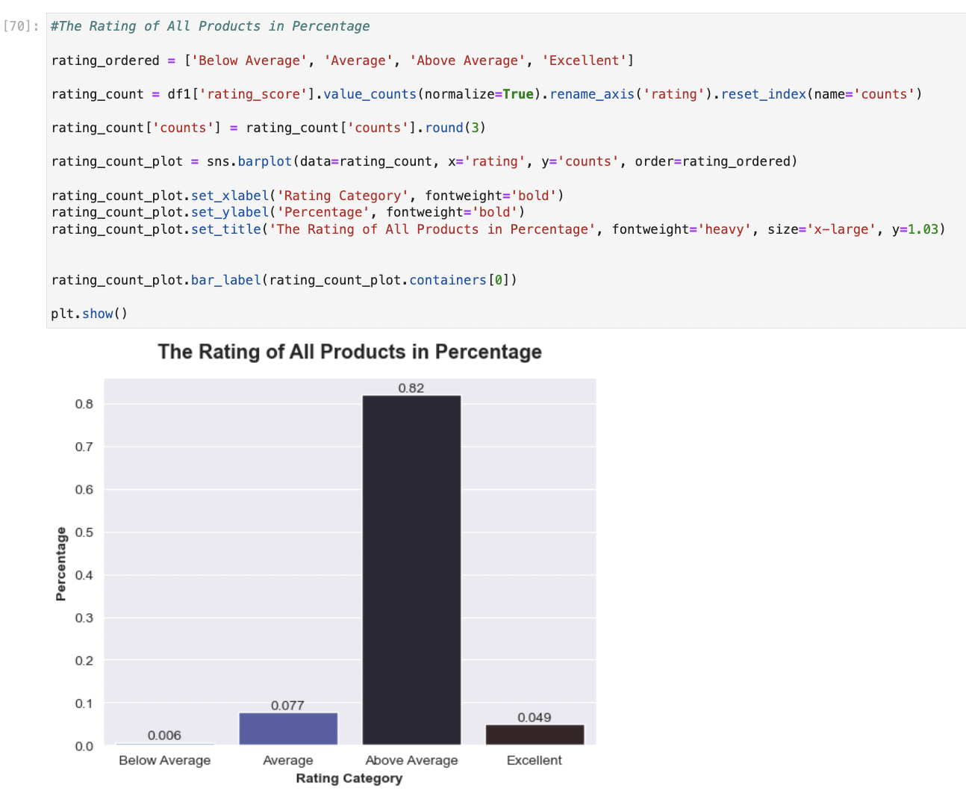
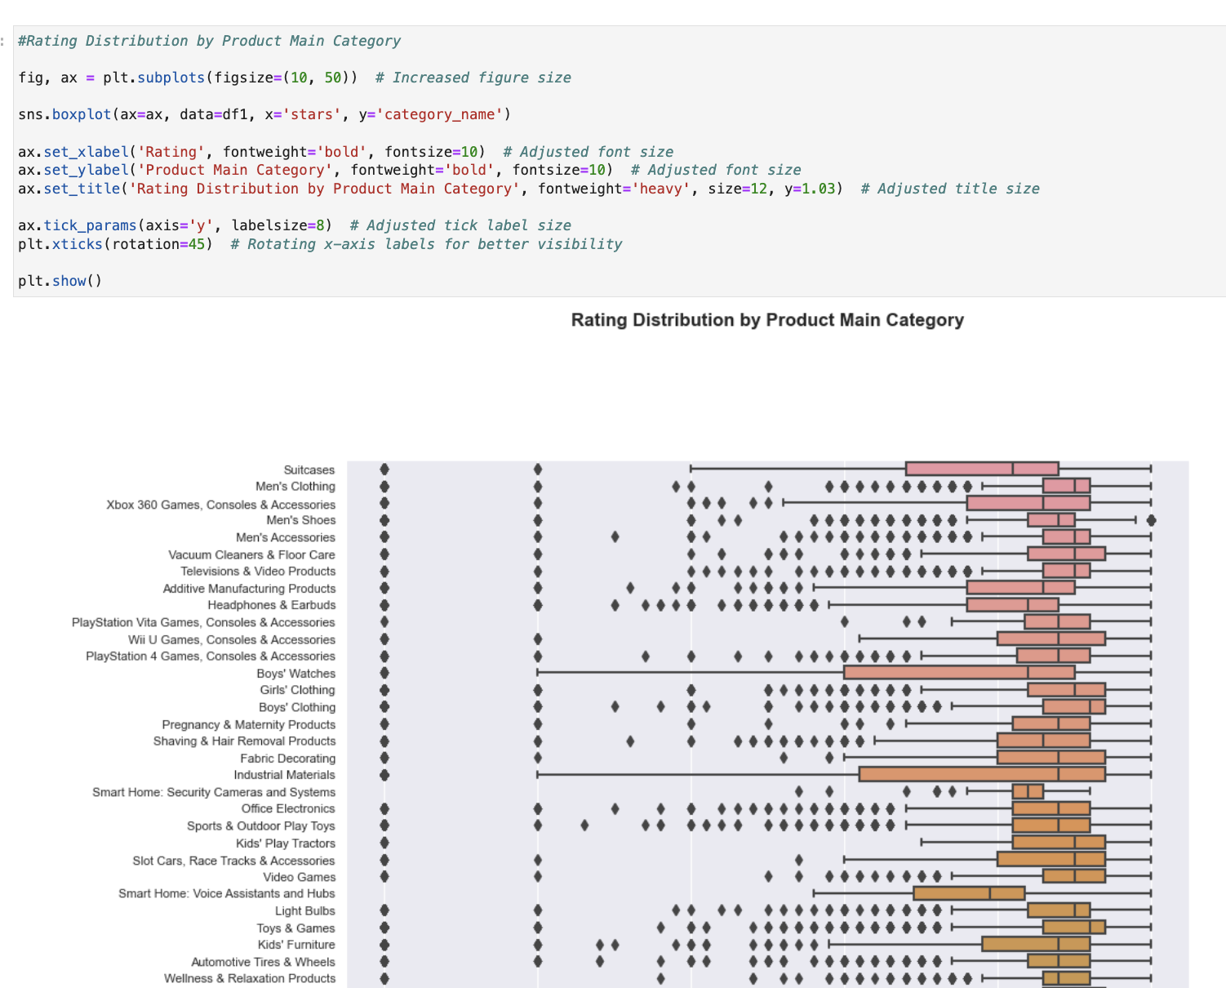

Slide 14
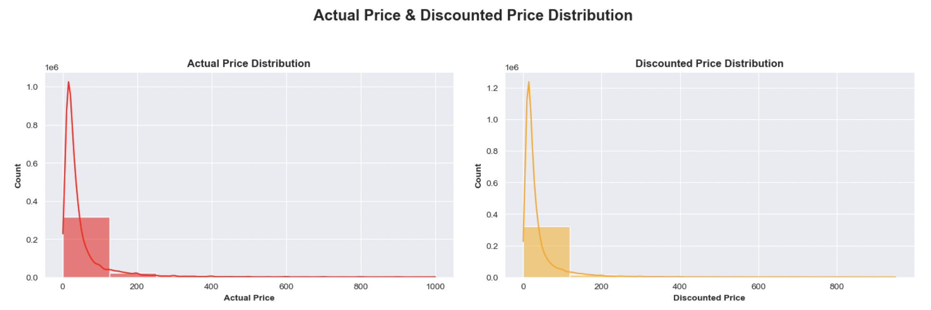
Observation 4: Product Rating

Slide 15
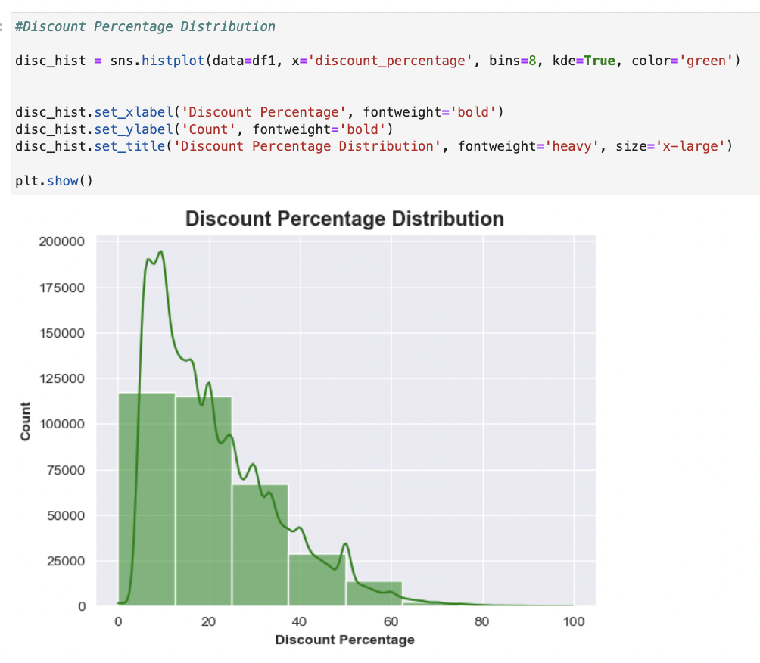
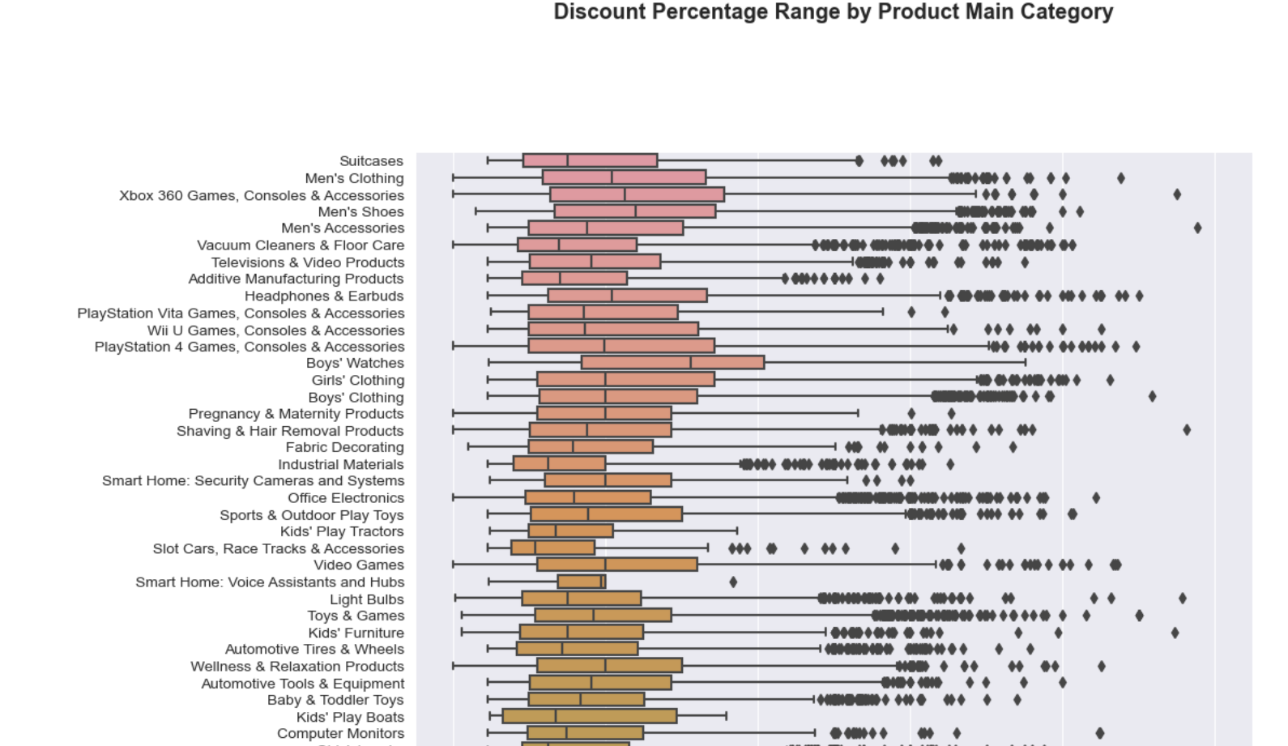

Slide 16

Model Evaluation and Metrics

Slide 17

Prediction of discounted price of products:
Ridge Regression:
Ridge Regression is primarily used to address the problem of multicollinearity in linear regression models. Multicollinearity occurs when predictor variables in a model are highly correlated.
Random Forest Regressor:
Random Forest Regressor is used for regression tasks. It operates by constructing a multitude of decision trees during training and outputs the mean prediction of the individual trees. It is effective for a wide range of regression problems and is known for handling overfitting well.

Slide 18
Predicting Sentiment of Products based on Ratings:
Multinomial Naïve Bayes: MNB classifier is a probabilistic learning method commonly used in Natural Language Processing (NLP) for text classification tasks. It is based on the Bayes theorem and the 'naive' assumption of conditional independence between every pair of features given the value of the class variable.
Logistic Regression: It is a classification algorithm used when the response variable is categorical. The algorithm predicts the probability of the target variable belonging to each category.

Slide 19

Result and Analysis

Slide 20
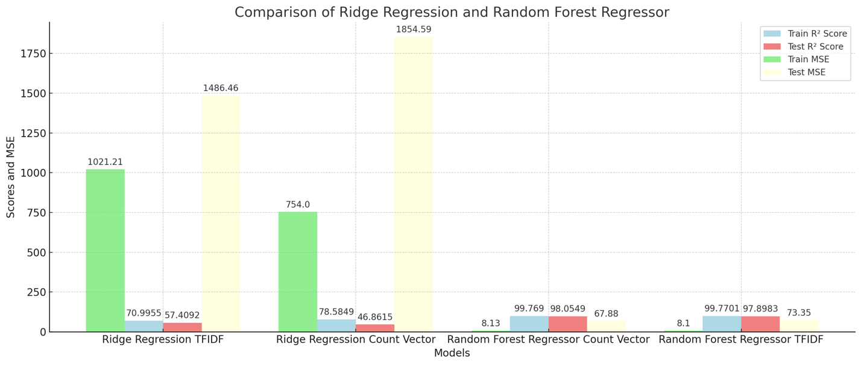
Prediction of discounted price of products:
The Random Forest Regressor significantly outperforms the Ridge Regression model in terms of Mean Squared Error (MSE) and R² (Coefficient of Determination) for both training and testing sets, regardless of the feature extraction method used.
Ridge Regression shows higher MSEs, indicating less accurate predictions compared to Random Forest.
For critical applications on this dataset, Random Forest should be considered due to its superior performance metrics. However, for applications where computational efficiency is key, Ridge Regression might be more suitable despite its lower accuracy

Slide 21
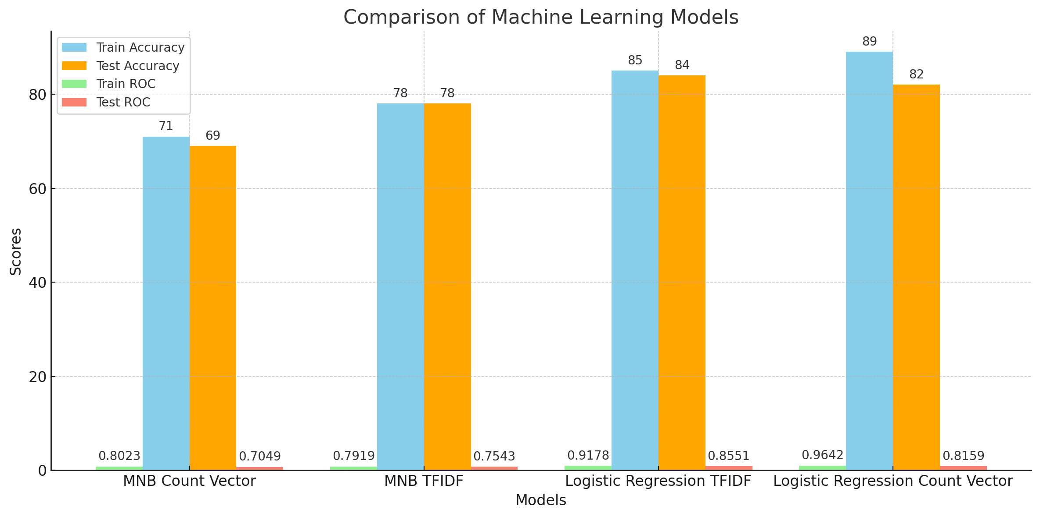
Predicting Sentiment of products:
Logistic Regression shows a more consistent performance between training and test data compared to MNB, suggesting better generalization capability.
Logistic Regression tends to have higher precision, recall, and F1-scores, especially with Count Vector. This indicates a stronger capability in correctly classifying different classes, particularly in multiclass settings.
Given its overall superior performance, Logistic Regression appears to be a more robust and accurate model for this particular text classification task.

Slide 22

Thank you

